Slide 1
Country sales report
POWER BI CAPSTONE 2

Slide 2
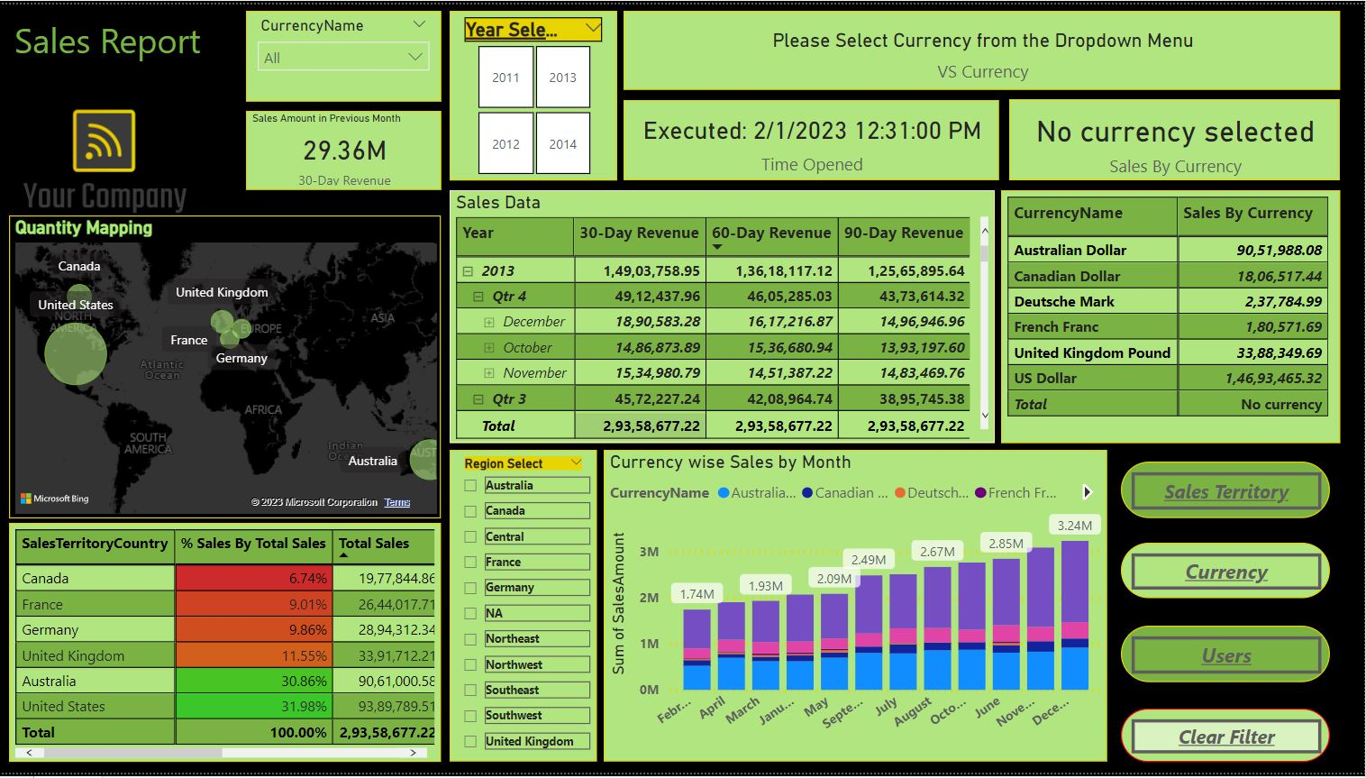
Post visualization presentation

Slide 3
TYPES OF Visualizations used
Cards
Map
Matrix
Line & Stacked Column Chart
Slicers
Images
Text Box
Buttons

Slide 4

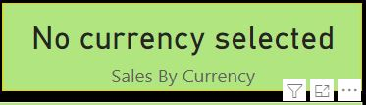


Types of visualizations used
Cards(NOW())
Cards(Currency Sales)
Cards(Previous Month Sales)
Cards(Selected Currency VS All)

Slide 5
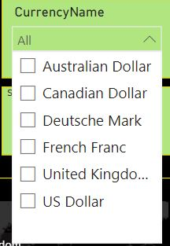
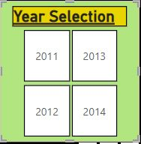
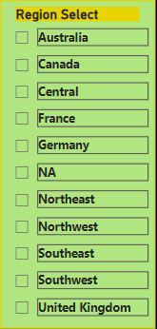
Types of visualizations used
SLICERS(Currency Slicer)
SLICERS(Year Slicer)
SLICERS(Region Slicer)

Slide 6
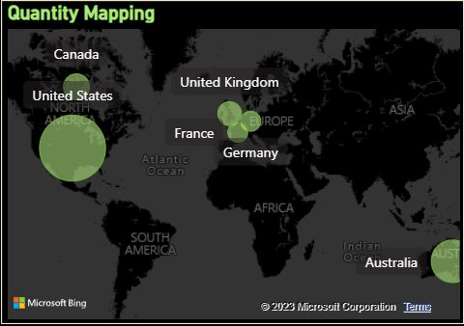
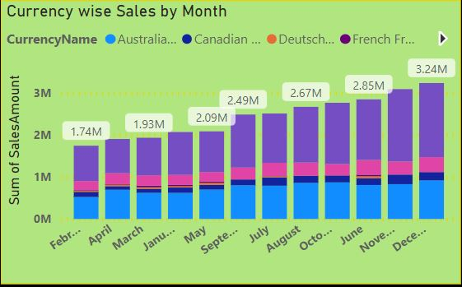
Types of visualizations used
MAP
Line & Stacked Column Chart

Slide 7
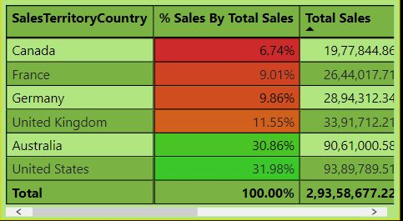
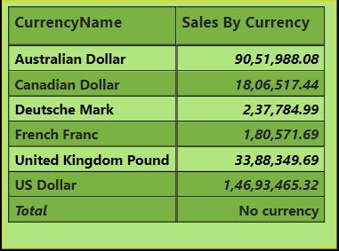
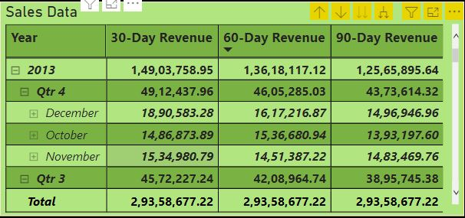
Types of visualizations used
MATRIX(Sales by Territory)
MATRIX(Sales By Currency)
MATRIX(Sales by Date)

Slide 8

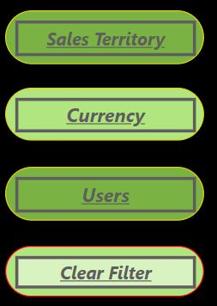
Types of visualizations used
IMAGE
BUTTONS

Slide 9
Types of FUNCTIONS used
Text functions
Date functions
STATISTICAL FUNCTIONS
Logical functions
Time functions
Statistical functions

Slide 10
Types of Functions Used
Date Functions :- date datediff DATEADD DAY MONTH YEAR EOMONTH
TIME FUNCTIONS:- HOUR MIN NOW TIME TIMEVALUE

Slide 11
Types of Functions Used
TEXT FUNCTIONS :- LEFT LEN UPPER SEARCH REPLACE TRIM
STATISTICAL FUNCTIONS:- COUNT SUM MAX MIN AVG SUMX COUNTX

Slide 12
Types of Functions Used
LOGICAL FUNCTIONS :- AND OR IF IN SWITCH TRUE FALSE

Slide 13
Data Sets Used
LOGICAL FUNCTIONS :- AND OR IF IN SWITCH TRUE FALSE

Slide 14
Data Sets Used
Currency
Customers
Date
Product
Sales territory
Internet sales

Slide 15
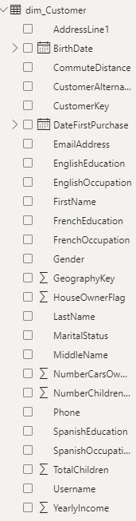
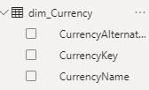
Data Sets Used
currency
Customers

Slide 16
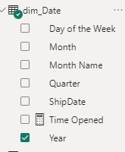
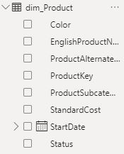
Data Sets Used
DATE
Product

Slide 17
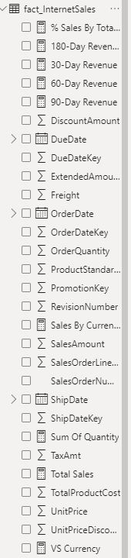
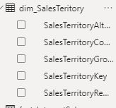
Data Sets Used
Sales Territory
Internet Sales

